Slide 1
MAZE
Defending the physical

Slide 2
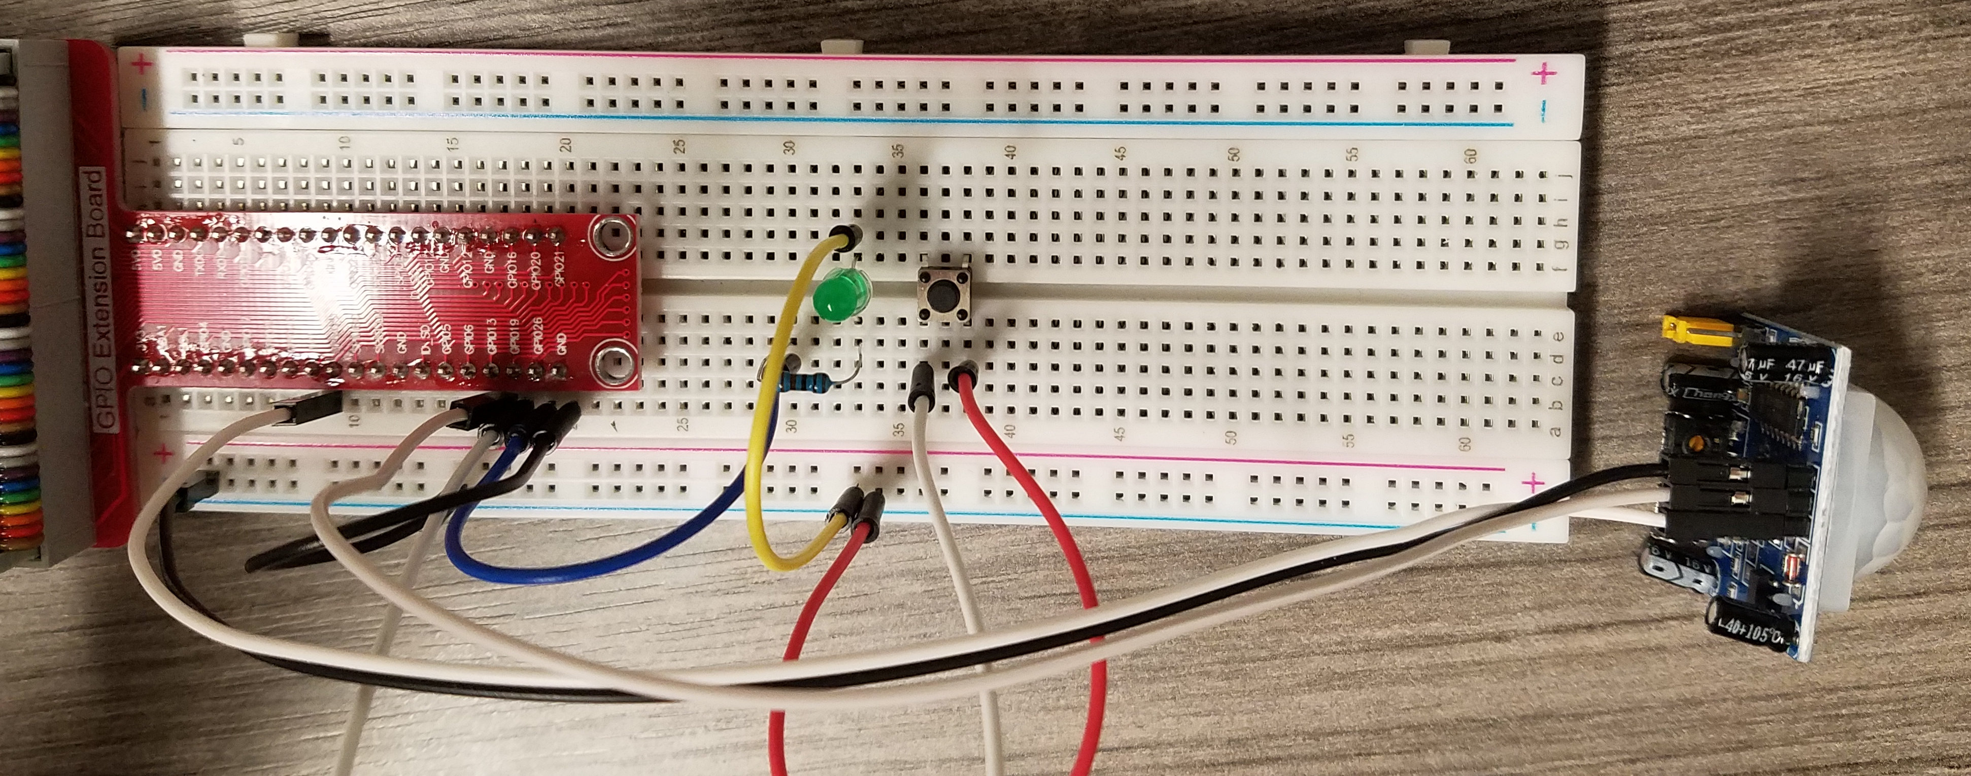
Adding a reset button
PIR Sensor to GPIO 13
Distance sensor to GPIO 23 and 24
LED to GPIO26
Button to GPIO19
python3 maze.py

Slide 3
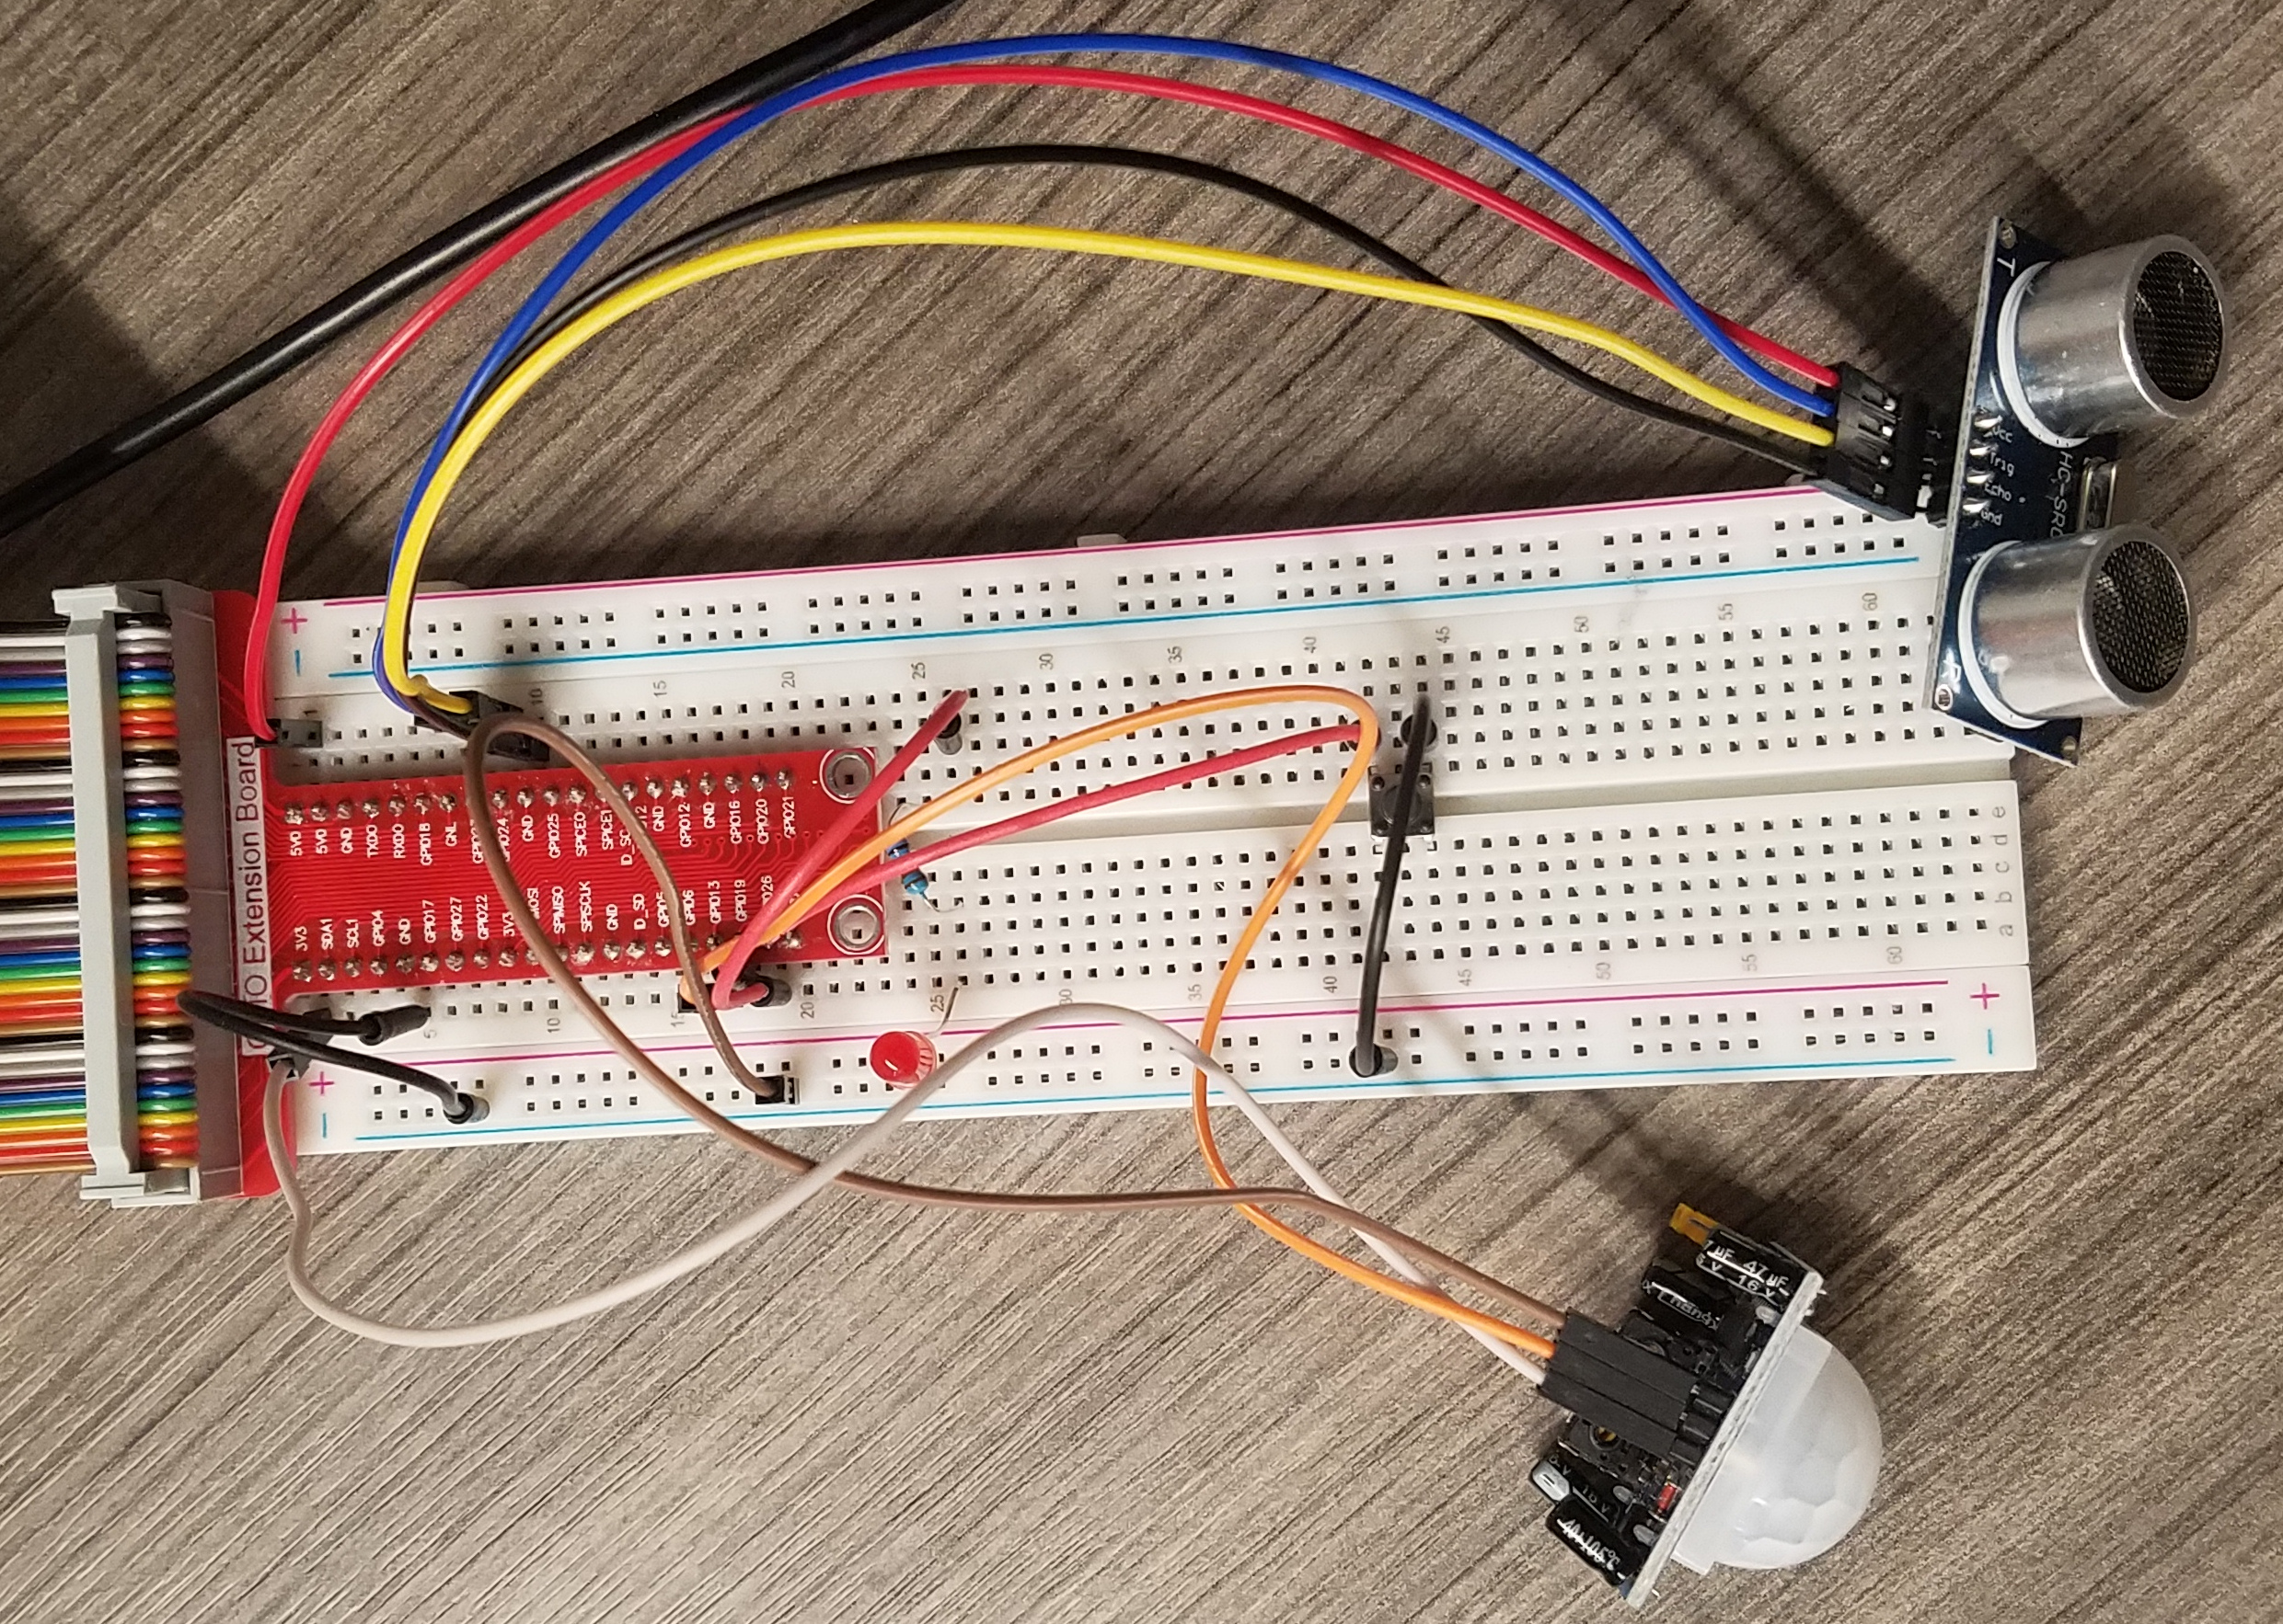
Multiple sensors in concert
Connect the PIR sensor and/or the distance sensor
Connect the button and LED as before
Configure maze.py
Determine if you want 1 or both sensors
Set max_distance
Alter the code if you want
How do we run it automatically?

Slide 4
Cron
Periodic tasks can be run with cron
crontab -e
Scroll to the bottom and add:
@reboot /home/pi/project/2021_gencyber_summer_camp/resources/day5/maze.py
Reboot the pi with: sudo shutdown -r 0
The script will now run without connecting keyboard/mouse/monitor

Slide 5
Maze
5 teams defend while 1 attacks
Defending teams place sensors (max 1 per table).
Defending teams must retrieve 5 objects. False alarms earn attacking team points
Attacking teams must retrieve 5 objects while triggering as few alarms as possible. Earn 3 points per item retrieved.
Correctly triggered alarms earn points for all defending teams

